Slide 1
Artificial Neural Network (CS642)
Lecture 01 - Introduction to Machine Learning
Dr. Abdul Basit
Associate Professor - CSIT University of Balochistan
October 24, 2025
ANN - Introduction to Machine Learning

Slide 2





Contents
1
Introduction
Applications
Data
Artificial Neural Network
How Deep is deep?
ANN - Introduction to Machine Learning

Slide 3
What is machine learning?
Machine learning is an application of artificial intelligence (AI) that provides systems the ability to automatically learn and improve from experience without being explicitly programmed.
Machine learning focuses on the development of computer programs that can access data and use it learn for themselves.
ANN - Introduction to Machine Learning

Slide 4


Contents
1
Introduction
Applications
Data
Artificial Neural Network
How Deep is deep?
ANN - Introduction to Machine Learning

Slide 5
What is machine learning?
Computer Vision Image Processing Marketing
Search Engines Object Recognition Face Recognition
ANN - Introduction to Machine Learning

Slide 6
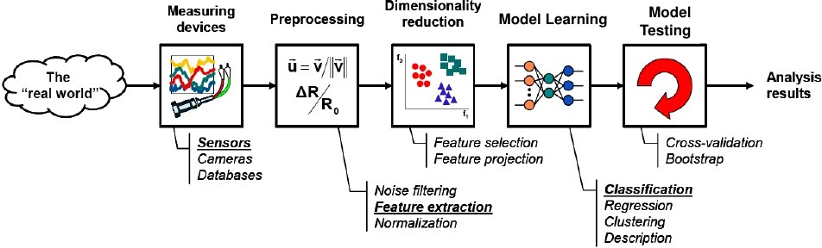
What is machine learning?
ANN - Introduction to Machine Learning

Slide 7
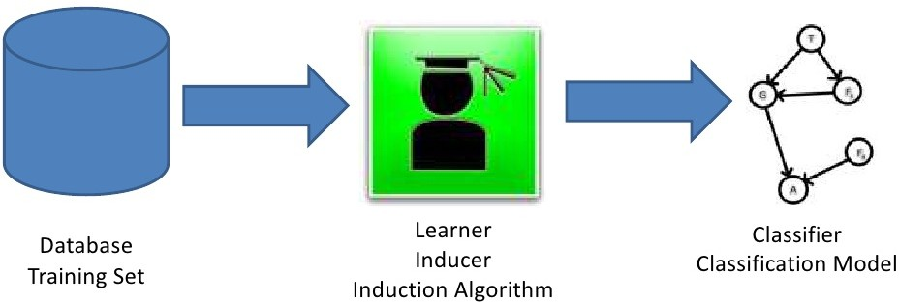
What is machine learning?
ANN - Introduction to Machine Learning

Slide 8
What is machine learning?
Supervised learning is the machine learning task of learning a function that maps an input to an output based on example input-output pairs.
It infers a function from labeled training data consisting of a set of training examples.
ANN - Introduction to Machine Learning

Slide 9

Contents
1
Introduction
Applications
Data
Artificial Neural Network
How Deep is deep?
ANN - Introduction to Machine Learning

Slide 10
Deep Learning
The central goal of AI is to provide a set of algorithms and techniques that can be used to solve problems that humans perform intuitively and near automatically, but are otherwise very challenging for computers.
ANN - Introduction to Machine Learning

Slide 11
Deep Learning
A great example of such a class of AI problems is interpreting and understanding the contents of an image – this task is something that a human can do with little-to-no effort, but it has proven to be extremely difficult for machines to accomplish
While AI embodies a large, diverse set of work related to automatic machine reasoning (infer- ence, planning, heuristics, etc.), the machine learning subfield tends to be specifically interested in pattern recognition and learning from data.
ANN - Introduction to Machine Learning

Slide 12

Contents
1
Introduction
Applications
Data
Artificial Neural Network
How Deep is deep?
ANN - Introduction to Machine Learning

Slide 13
Deep Learning
Deep Learning is a subfield of machine learning concerned with algorithms inspired by the structure and function of the brain called artificial neural networks.
ANN - Introduction to Machine Learning

Slide 14

Contents
1
Introduction
Applications
Data
Artificial Neural Network
How Deep is deep?
ANN - Introduction to Machine Learning

Slide 15
Deep Learning
When you hear the term deep learning, just think of a large, deep neural net. Deep refers to the number of layers typically and so this kind of the popular term that’s been adopted in the press.
ANN - Introduction to Machine Learning

Slide 16
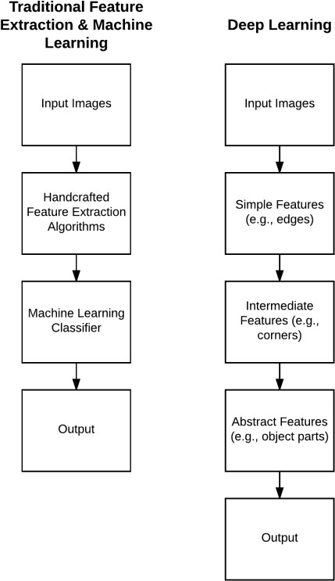
How deep is deep?
ANN - Introduction to Machine Learning

Slide 17
Deep Learning
Convolutional Neural Network (CNN) is a type of deep learning algorithm. But suppose we had a CNN with only one convolutional layer – is a network that is shallow, but yet still belongs to a family of algorithms inside the deep learning camp considered to be “deep”?
ANN - Introduction to Machine Learning

Slide 18
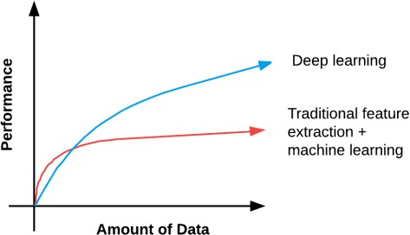
How deep is deep?
ANN - Introduction to Machine Learning

Slide 19
Deep Learning
Are you using a specialized network architecture such as Convolutional Neural Networks, Recurrent Neural Networks, or Long Short-Term Memory (LSTM) networks? If so, yes, you are performing deep learning.
Does your network have a depth ¿ 2? If yes, you are doing deep learning.
Does your network have a depth ¿ 10? If so, you are performing very deep learning [40].
ANN - Introduction to Machine Learning

Slide 20
The End

